Slide 1
TITLE PAGE
Problem Statement Title-Telemedicine Access For Rural Healthcare In Rural India
Theme- MedTech/ BioTech/ HealthTech
PS Category- Software
Team Name ( Registered On Portal ) - Getch();

Slide 2
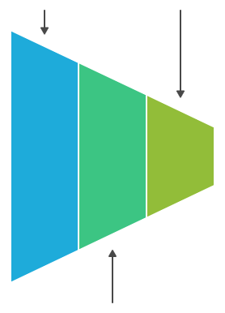
HealthGaurd
Getch();
Proposed Solution
Target Population
Serving 173 Villages
Doctor Shortage
Only 11 Doctors for 23 sanctioned posts at rural area Civil Hospital
Nurse Availability
Total Nurses in Nabha: Ranging between 76-94
Pharmacy Access
Total Pharmacies (Govt. + Private): 131
Connectivity Gap
Only 31% of rural Punjab has internet access, It ensures SMS/offline features are essential.
Comprehensive healthcare ecosystem
HealthGuard is a robust application that connects patients, HW, and doctors. It aims to close healthcare gap in rural areas. It has an ML model that provides constant care
Low Tech communication
Implements SMS/WhatsApp and video for communication. This validates low-tech accessibility and real-time interaction for all rural users.
AI-Powered Symptom Triage
System will use a trained ML model on health data to predict the common diseases based on reported symptoms. It will flag high-risk cases for immediate attention.
Hyperlocal Pharmacy Integration
A real-time list of all government and private pharmacies in rural area helps users find needed medicines and check for generic options.
Multilingual
Support
Design to support local dialects ensures wide user coverage, for example, Marathi. This provides easy interaction with platform.
One-Tap SOS Alert
An emergency button immediately notifies the nearest HW and rural area Civil Hospital with the patient's real-time location.
ML Model
Prediction
Provide Decision
Making
Patient
Data
Collection
Informed Treatment
Plan
AI Report Generation

Slide 3












TECHNICAL APPROACH
Getch();
Technology Stack
HealthGuard Flowchart
Website / login page
Patient
Check Symptoms
Triage Report
ML model Prediction
H.W.
login
AI Report
Suggest Pharmacy
Check availability
Prescription
Consultation with Doctor
HW Insights
Home remedies
Generate Final Report
Send SMS
END
Primary Care
Save report to database for medical history
AI automation will send regular reminders regarding medicine and clinic revisit.
Patient
H.W.
If still not feeling well

Slide 4
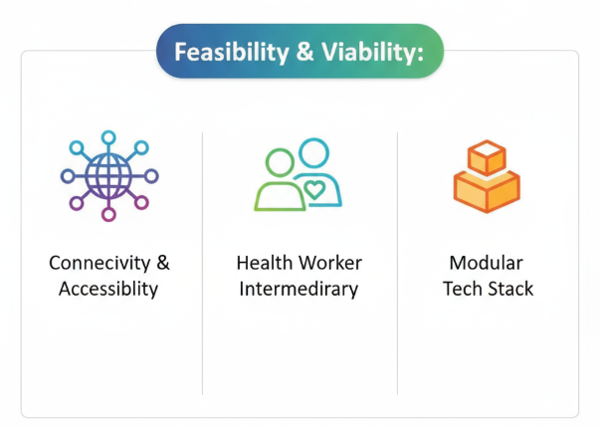






FEASIBILITY AND VIABILITY
Getch();
CHALLENGES:
STRATEGIES to OVERCOME CHALLENGES:
Poor Internet Connection: Despite growth consistent,
constant speed internet remains a major obstacle.
Prioritize SMS based architecture
for important task to
ensure service relevancy
for the most affected areas
Leverage widely available resources making deployment possible in areas with limited network access resources.
Incorporate Aasha Health-Workers as an intermediaries increasing user adoption and practical workflow.
Modular Tech Stack allows scaling from stand alone to last deployment
Medicine Stock Management: Take a track on real time data of pharmaceutical is very difficult
Implemented Pharmacy module to reflect real time stock updates of medicine across various pharmacies.
Digital Skill Awareness: Low
digital literacy in some patient groups and even Health Workers
Continuous training
for health workers to
boost accuracy and
reduce mistakes
It is very complex to access healthcare with the more complex tech and complex features in existing solutions.
Implement data encryption, accesses control, and compliance
with health data regulations

Slide 5


IMPACTS AND BENEFITS
Getch();
Social: Bridges healthcare gap by helping rural communities and providing access to timely medical advice..
Economic: Minimizes travel cost and time away from work by providing remote consultation and updating system efficiency.
Healthcare: Improves early detection, follow-up, and medication adherence with real-time alerts, reminders, and organized consultations.
Technological: Uses simple technology such as SMS, WhatsApp, and the web Toolkit to ensure reach and utilization. This ensures it is scalable for different regions
Prediction Model: After implementation, we can predict the type of seasonal diseases throughout the year. Based on the data stored in the past, we can train the prediction module.
Real-World Scenario
An patient in a remote village near rural area has their blood pressure checked by a local ASHA worker.
The worker sends an SMS with the high reading to our system using the patient's basic handset.
The system quickly identifies the risk and sends an alert back to the ASHA worker's phone.
The worker access the patient's symptoms on the platform and schedules a priority appointment at the nearest government hospital.
Impact & Benefits
This platform provides essential observation for chronic care patients without needing any fast internet connection.
It simplifies doctor consultations by delivering organized data before
the appointment starts.
The alert system enables quick action in high-risk situations to help prevent emergencies.
Ultimately, it connects rural patients directly to government healthcare services.

Slide 6
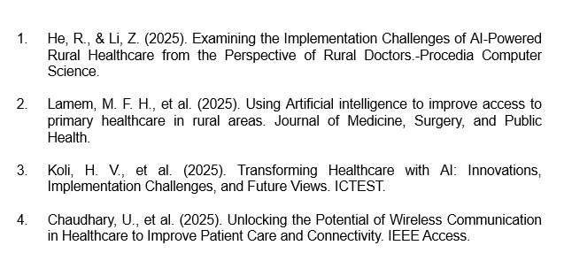
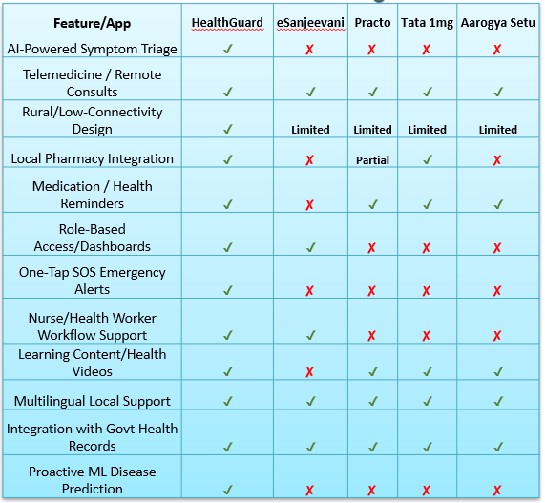
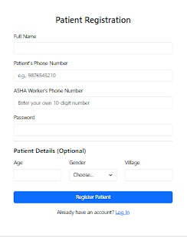
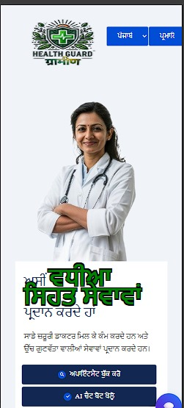
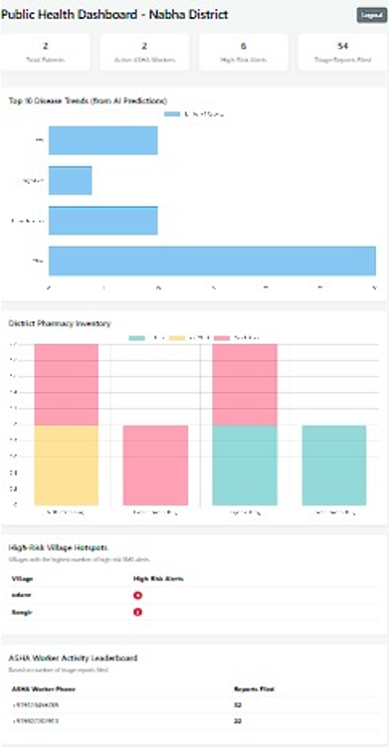
RESEARCH AND REFERENCES
Getch();

